Slide 1
Introduction to Programming in Python
Ezekiel Adebayo Ogundepo (@gbganalyst)

Slide 2
Making decisions in Python

Slide 3
Conditional Statements in Python
Programming languages provide various control structures that allow for more complicated execution paths.

Slide 4
Types of loop
There are two types of loops in Python
for loop and
while loop

Slide 5
The for loop
A for loop is used to iterate over a sequence of object such as list, tuple, set, string or a dictionary.
For loop syntax
for item in object:
statements to do
The naming of the item is completely up to you, so use your best judgment for choosing a name that makes sense and you will be able to understand when revisiting your code.

Slide 6
The while loop
A while loop will repeatedly execute a single statement or group of statements as long as the condition being checked is True. The reason it is called a ‘while loop’ is because the code statements are looped through over and over again until the condition is no longer True.
Syntax of while Loop
while test_expression:
Body of while

Slide 7
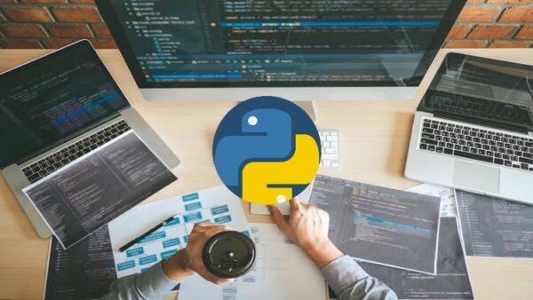
Lab session

